Slide 1
Literacy at KS3 level
Reading, Writing, Speaking and Listening
At home, you can:
Read to your child/ren or listen to them reading to you/retelling stories
Praise and encourage any written work they complete
Listen to your child’s experiences
Ask them to follow directions

Slide 2
Spelling and Literacy

Slide 3
KS3 Novels being studied

Slide 4
D - device | The writer uses _ (name device) _ to engage the reader and present the dangers of travelling in the desert.
E - evidence | For example, “(copy out evidence from text).”
A - analysis | This is effective as it cleverly captures…
L - link | All in all, the writer uses engaging language, such as _ (name a device) _ to undoubtedly present danger because...

Slide 6
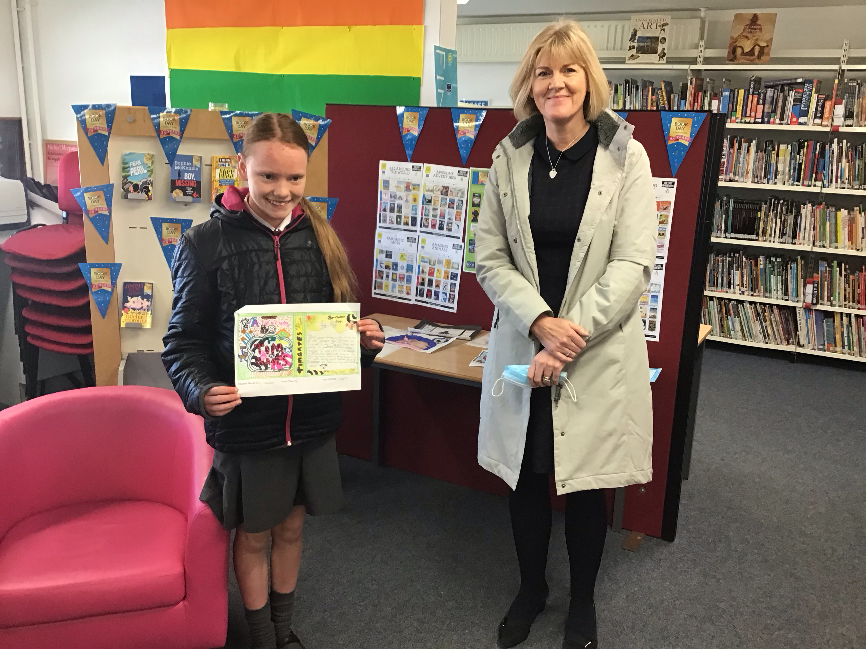
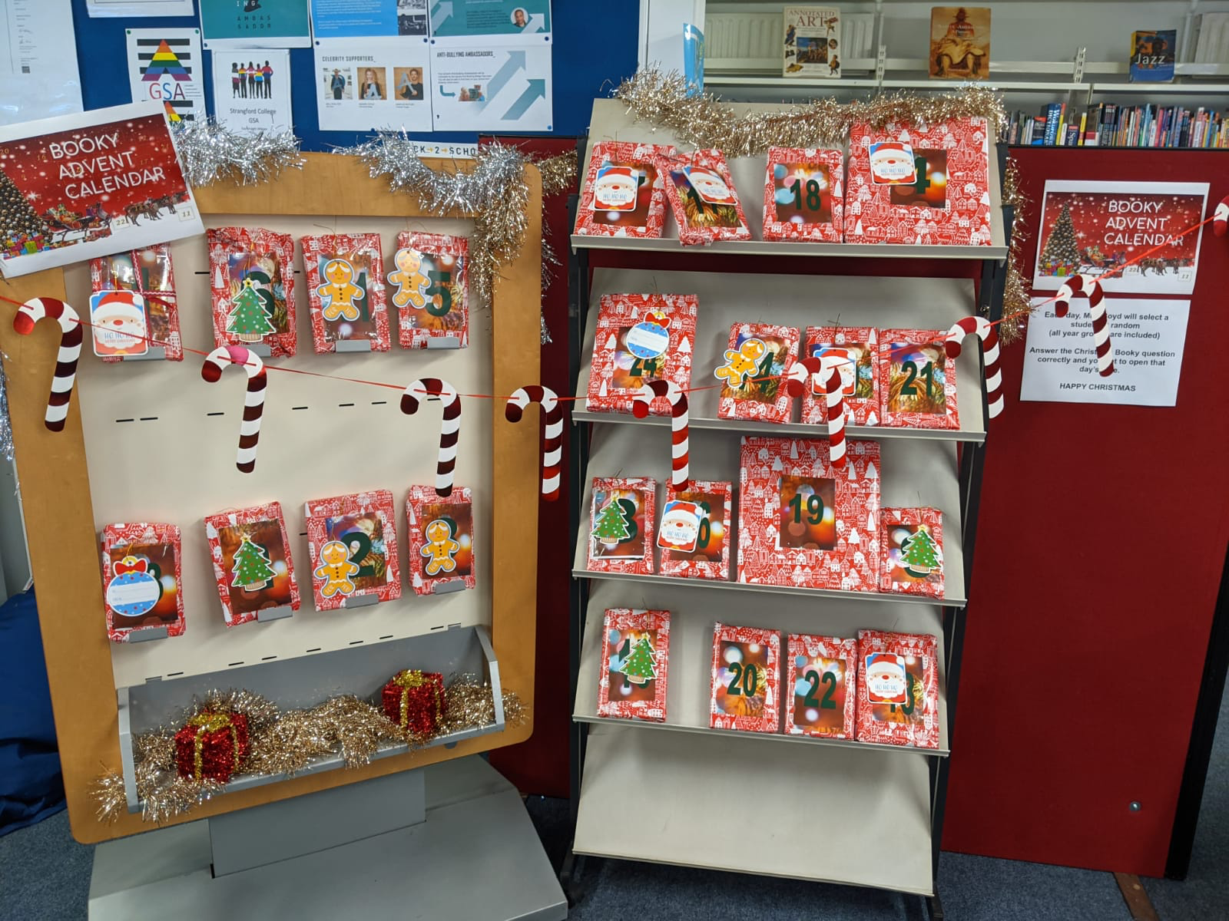
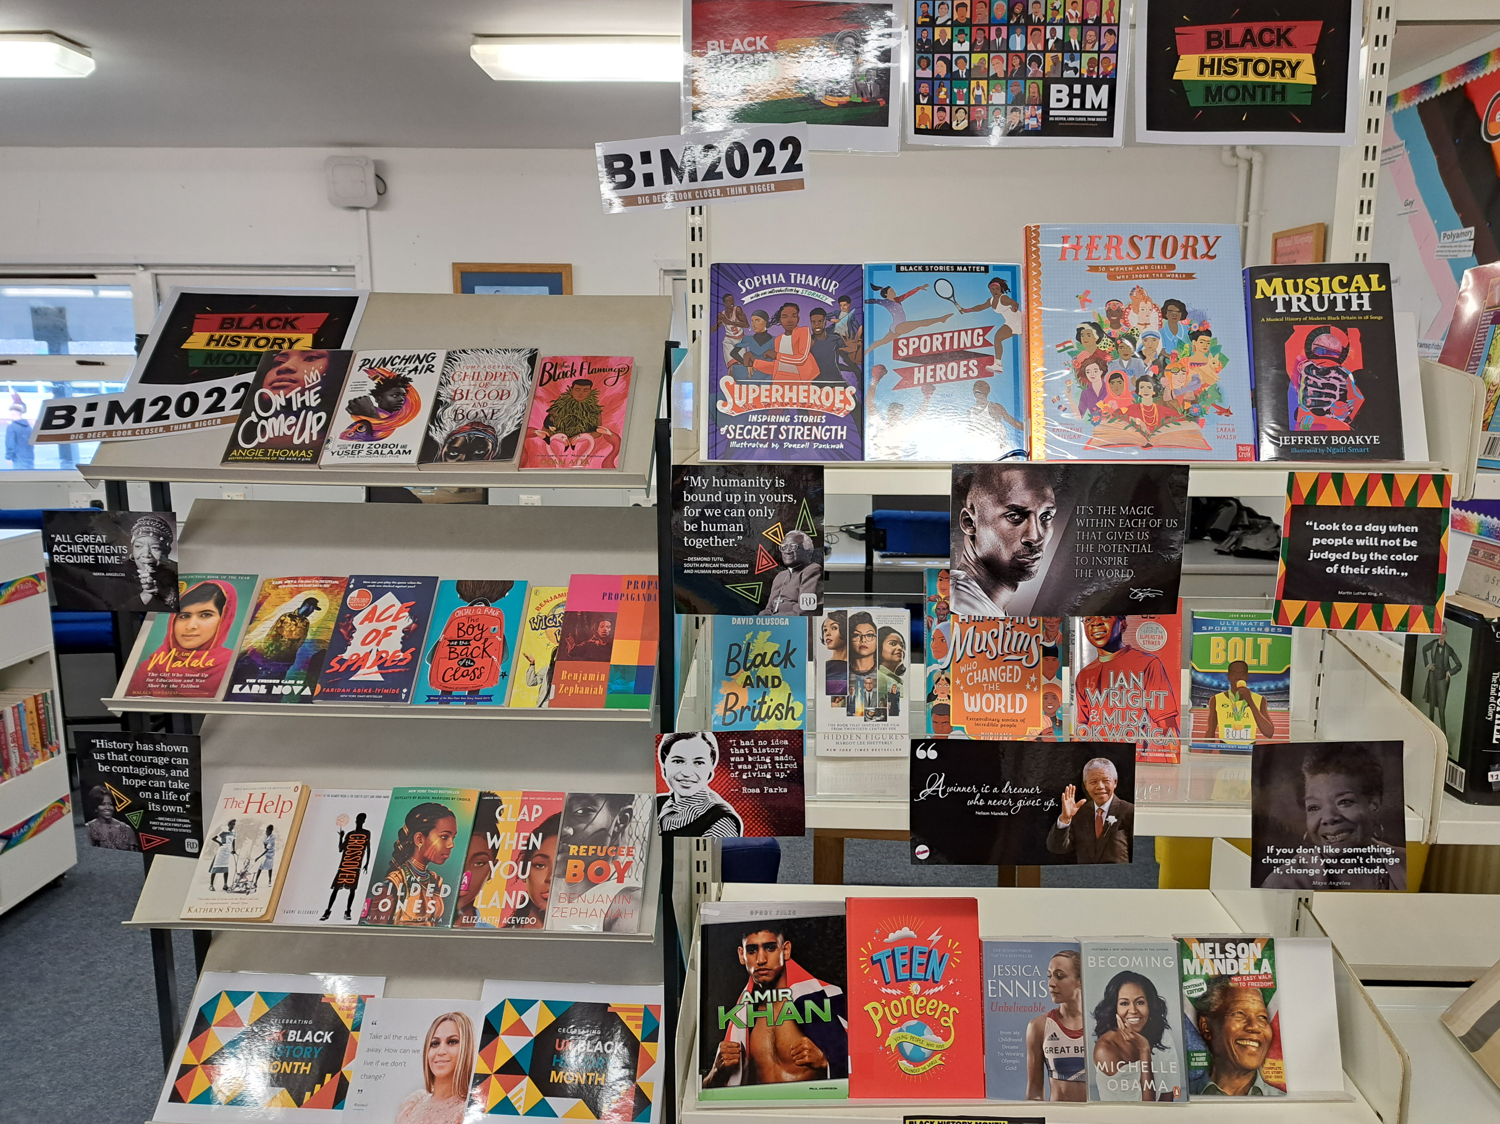
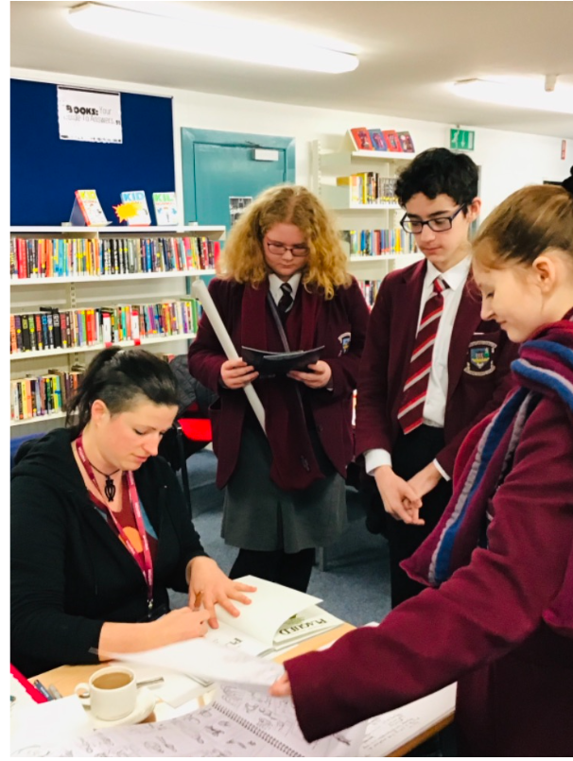
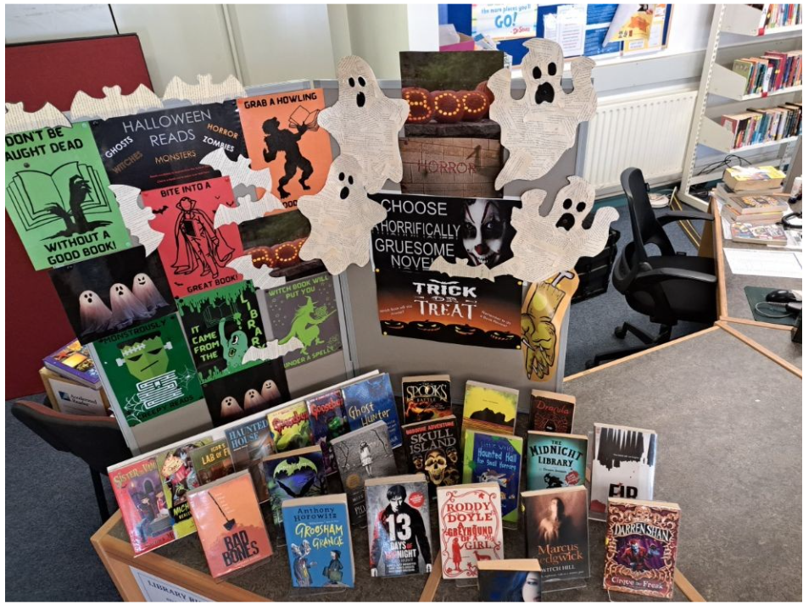

Slide 7
Useful Websites

