Slide 1
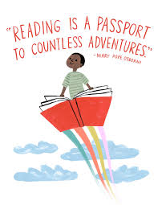
Ian Gow Memorial Library
Year 8 Reading List Recommendations
For September 2020

Slide 2
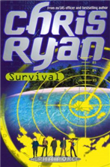
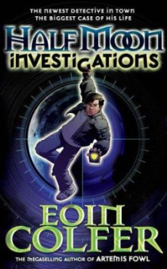
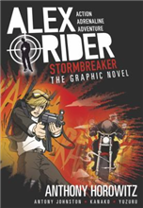
Suspense / Mystery / Thriller/ Adventure
Two computer whizz kids try to prove their father is innocent of bank theft.
AR 4.4
The ultra-tough, realistic novels of Chris Ryan are a must for those seeking excitement and thrills. This "Alpha Force" novel is the start of a gripping series
AR 5.7
After completing a dodgy online course , 12 year old Fletch reckons he's a fully fledged detective! Chaos follows in this great thriller.
AR 4.2
The first in a popular series about the young James Bond, when he was still at school.
AR 5.9
Graphic Novel of 1st book
in the series... When his guardian dies in suspicious circumstances, 14 yr old Alex Rider becomes involved with MI6 and has to complete his dead guardian's mission.
AR 2.4
When a bag stuffed full of money drops out of the sky Damian and Anthony find themselves rich. But they learn that there are some things money just cannot buy. AR4.0

Slide 3
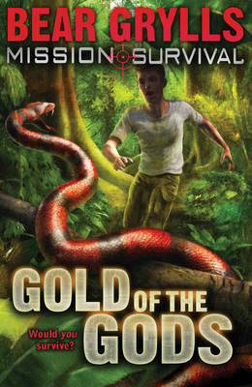
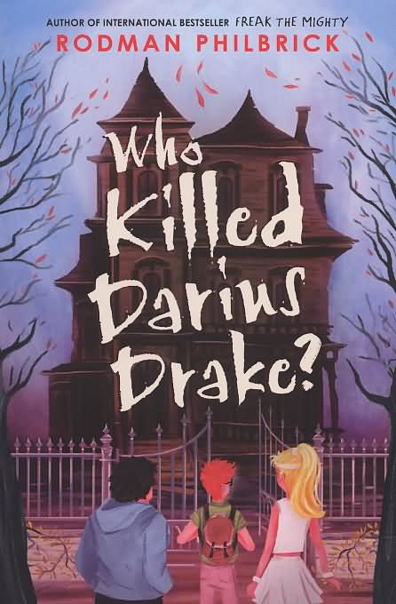
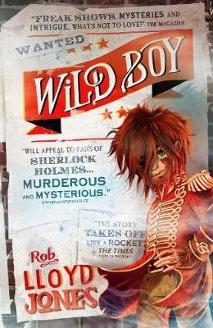
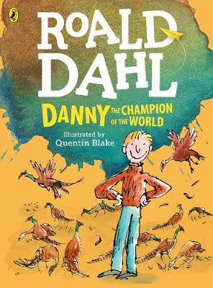
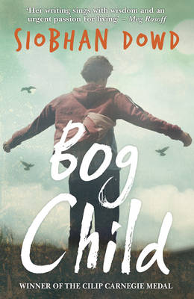
A boy uses his survival skills to help protect the lost jungle city of El Dorado
AR 6.3
The story of a girl's emigration to South America to meet her strange family and adventures on the Amazon river AR 5.6
A twelve year old girl moves to India when her dad gets a job managing a new hotel but she quickly finds out that the hotel is a front for illegal poachers. AR 4.2
When genius orphan, Darius, employs school tough guy, Arthur "Bash-Man", to help him find out who sent a note asking "Who Killed Darius Drake?", they get caught up in a mystery. AR 4.9
And one rule is the most important of all: she must never ever invite anyone home. If she does, their shameful secret - Abomination - could be revealed.
AR 3.8
A hair-covered young boy who is part of a freakshow, runs away from the circus when he is suspected of a murder he didn't commit. Develops a Sherlock Holmes style talent for observation and detection.
AR 4.6
The story of Danny and his father who outwit their greedy, rich neighbour, Mr Victor Hazell.
AR 4.7
Follows the aftermath of the discovery of a child's body found in a peat bog. An astonishing novel exploring the sacrifices made in the name of peace, and the unflinching strength of the human spirit.
AR 3.6

Slide 4
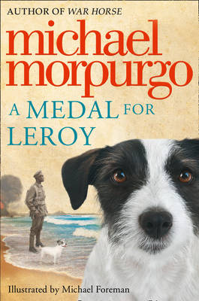
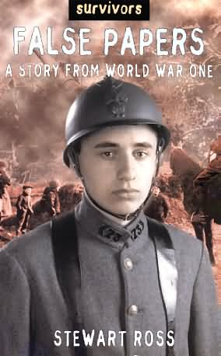
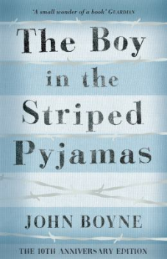
War / Historical
A young mixed, race boy discovers the history of his father, an RAF pilot who was killed during World War II. A realistic, engrossing, & emotional tale
AR 5.1
The Diary of a Young Girl remains the single most poignant true-life story to emerge from the Second World War.
AR 6.5
A young French boy attains false papers to sign up for the army in World War I and sees at first hand the horrors of war.
Set during the end of World War 2, a group of refugees escape Germany by ship. Based on a true story from the Second World War. When the German ship the Wilhelm Gustloff was sunk in port in early 1945 it had over 9000 civilian refugees, including children, on board. Nearly all were drowned. Award winning. AR 4.5
Evacuated from London to Wales during the Second World War, Carrie and her brother are sent to live with the very strict Mr Evans.
AR 5.3
A German boy befriends a Jew in a concentration camp, without realising the significance of the facility.
AR 5.8
Follows a young boy as he escapes from a convent orphanage in the mountains of Nazi occupied Poland in search of his parents. AR 4.1
Once is part of a series

Slide 5
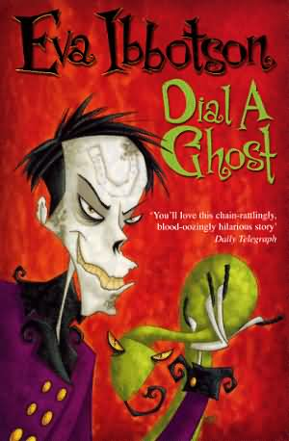
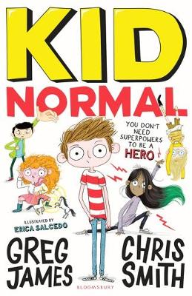
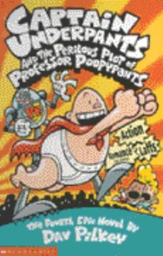
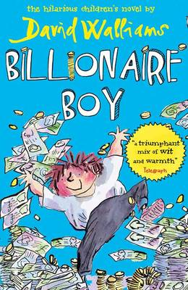
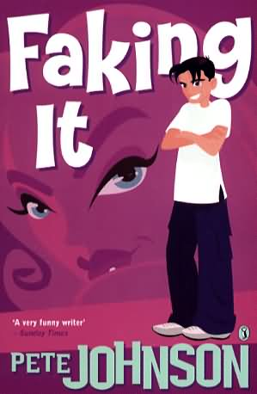
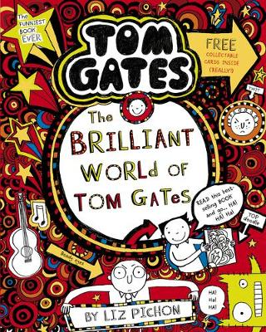
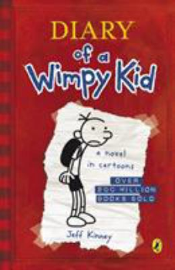
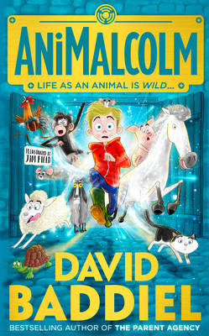
Humour / Funny
Untypical ghost story - these ghosts have 'people' problems. Excellent read. AR 5.7
Nate and his friends go into competition to try and beat their arch rivals at Jefferson Middle School.
AR 3.1
A boy without superpowers starts at a superhero school and helps to stop a wasp supervillain. Fun Read; 1st in the series. AR 6.2
George & Harold's headmaster in his guise of Captain Underpants takes on the powers of an alien science teacher to save his pupils and the world from his terror. Silly fun!
AR 4.7
Follows an American boy through a school year of activities, friendships and family life. Funny & popular, 1st in a series. AR 5.2
The lonely son of a billionaire toilet roll magnate starts at a comprehensive school incognito in the hope of making a new friend. A hilarious, touching and extraordinary new fable from David Walliams. AR 4.1
A boy with a dislike of all animals finds himself changing into a variety of four legged creatures and gets to see life from a different point of view. Laugh out loud funny. AR 4.1
The diary of a boy who invents a fake girlfriend. AR 4.4
Here comes Tom Gates – he’s no wimp!
Follows the life of a school boy, his rock band, DogZombies, and his battles with his teachers and his grumpy older sister. 1st in a series AR 4.0

Slide 6
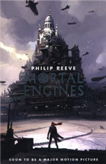
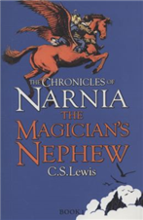
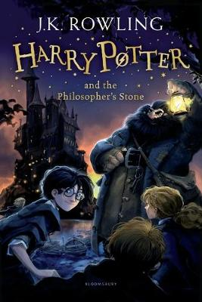
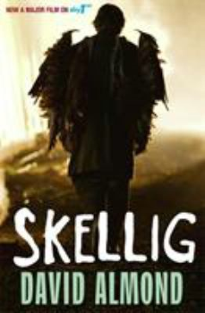
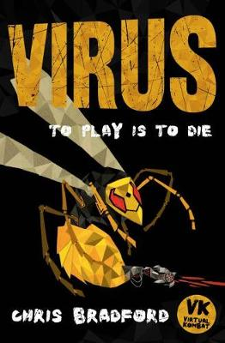
Fantasy/ Dystopia/ Science Fiction
A fantasy adventure in which cities roam the country demolishing smaller towns and looking for relics and technology of the Ancients. Unputdownable! AR 6.6
A girl survives on an island after a catastrophic flood separates her from her family. Good "disaster survival" adventure. AR 3.7
The Iron Man is a classic tale about a boy and a robot defending Earth from a creature in outer space. AR 4.7
Two children travel to different lands by ways of magical rings. 1st in the classic series of tales in Narnia. AR 5.4
A boy feels neglected when his baby sister is ill, but he makes two new friends - a confident home-educated neighbour & a strange creature that lives in the shed. Gripping fantasy story.
AR 3.5
The Wish List - After dying in a botched burglary, Meg has to redeem her soul by granting the wishes of the pensioner whom she tried to rob. A funny, irreverent, gripping read. AR 4.0
1st book in this excellent fantasy series. A boy enrols at a Wizard school and has amazing adventures.
AR 6.0
For Phoenix its easy. He hates his new home and the new school where he is bullied. He's embarrassed by his computer geek dad. But when he logs into The Legendeer, the game his dad is working on, he can be a hero. He is Theseus fighting the terrible Minotaur, or Perseus battling with snake-haired Medusa. The trouble is The Legendeer is more than just a game. Play it if you dare! AR 4.5
On the run from the makers of the deadly virtual reality game, Virtual Kombat, Scott meets a group of hackers who have created a virus which could destroy the game. AR 4.5

Slide 7
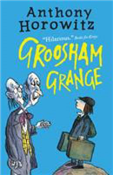
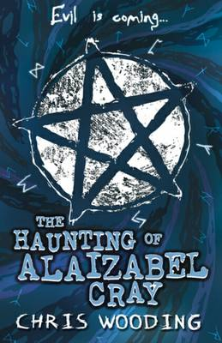
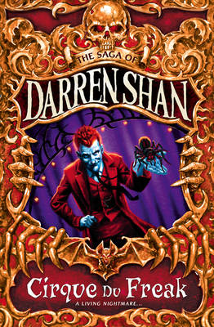
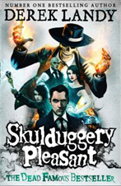
Ghost / Horror
A graphic adaptation of Gaiman's novel.When Coraline moves to a new house she is fascinated by the fact that their house is in fact only half a house. Divided into flats years before, the other flat, it soon becomes clear to Coraline, is not quite as cosy and safe as her own. AR 3.6
Gripping page turner full of intrigue and mystery. Unexplained deaths start to occur in Chust and when a band of Gypsies arrive in the village Peter discovers his father has been keeping secrets from him and owns a sword that can stop the dead coming to life again. AR 4.9
A boy is sent to a boarding school where he encounters some very strange teachers and practices. 1st in a series. AR 4.8
A 17 year old wych-hunter tracks down the wych-kin creatures that lurk in the Old Quarter of London. AR 7.1
Darren Shan is just an ordinary school boy until he gets an invite to the Cirque de Freak...until he meets Madame Octa...until he comes face-to-face with a creature of the night. Good gripping horror. AR 4.8
Wacky, amusing & highly entertaining. Stephanie joins forces with her dead uncle's companion, Skulduggery Pleasant (the living skeleton of a dead wizard), against the evil forces of wizards set on destroying the world.
AR 4.9
Popular Goosebumps series, spooky read. A 12-year-old boy is given a mirror which enables him to turn invisible but he discovers his reflection wants to escape. AR 3.3

Slide 8
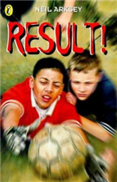
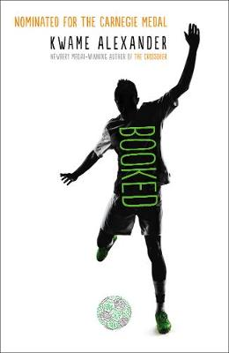
Sport
Crossover is an absorbing story that will appeal to basketball fans, despite strong US feel. Verse format makes for a quick read that still has emotional depth. Twin brothers who are rivals both on and off the basketball court. AR 4.3
A group of boys use football to prove themselves. Ash is always the goalie- and he hates it. Determined to be a striker, he joins Cas's tough free-for-all game outside of school. Playing up front at last, he's happy - until the challenge match arrives. Suddenly everything's at stake for Cas and he wants Ash to play in goal
When Steven's mother wants him to move with her to a new town he can't decide between playing rugby league or rugby union and leaving his dad behind. One game, Two codes, One choice AR 3.2
Compelling & thought-provoking read. A tale of two boys - one a Catholic, one a Protestant - whose attempt to help an outsider is set against the sectarian prejudices around them in Glasgow when the annual Orange Walks begin. A tale about two boys who must find their own answers - and their own way forward - in a world divided by differences. AR 4.3
Verse format is light and easy to read. Charming tale with lots of word play, punning jokes and likeable male lead. More than a football story! A boy hoping to make it to the world of big league football is set back by the break up of his parents. AR 3.9
Pacy, flowing adventure. 1st in a series. A soccer fan investigates a football hero's kidnapping. AR 3.7

Slide 9
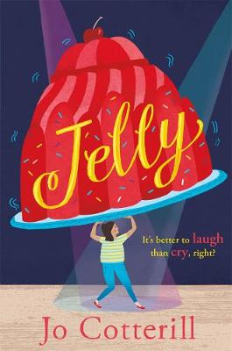
Family / Teen/ Friendship / Difference
A teen girl's life is turned upside down when her estranged mother returns from America after 11 years. Story is tender and well written – a wonderful read. AR 3.8
Izzie is cool, bright and sassy. And when she meets the gorgeous Mark, she's on a real high. He's divine. And he likes her! But why doesn't he call when he says he will? AR 3.8
A sweet, warm, reassuring story, dealing with some big issues. A young girl gains confidence when she performs her poem at the school contest. Angelica (nicknamed Jelly), aged 11, is the life and soul of the classroom. She's popular and great at doing impressions. She's also overweight. She's learned to deal with the put-downs by brushing them off and pretending she finds it all very funny - while making up poems and writing her private worries in a notebook. AR 4.4
A boy falls in loves with a girl who has an eccentric personality and finds it difficult to fit in with normal society. “Stargirl" is a classic of our time that celebrates being true to ourselves and the thrill of first love. A life-changing read that touches souls of all ages. AR 4.2
Dother Hall Performing Arts College is not quite the showbiz experience Tallulah was expecting. But once her mates turn up and they start their summer course things are bound to perk up. Entertaining and amusing with spot-on teenage angst & a wacky supporting cast.
AR 4.2
Follow Nikki's life through sketches, doodles and diary entries as she starts her new school, battles with her mum for an iPhone and meets her arch-nemisis, the school's queen bee, Mackenzie. First in the series. AR 5.4

Slide 10
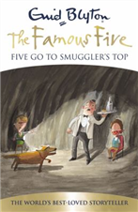
Other Recommended Reads...
Gripping & violent tale which leaves plenty of food for thought. Excellent.
If you are starting Secondary School, this story could help you survive. Also, you'll probably laugh your guts out on every page. 1st is series
On the first day at her new school, Dinah realizes something is horribly wrong. What is the secret of the Headmaster's control?
A young girl realises the racism in her neighbourhood when a black family move in next door. A moving novel that tackles neighbourhood prejudice.
Tense, pacy all action tale with dual gender appeal. A well- crafted, engaging accessible short read. 1st in a series
The classic story of a spider saving a pig from its usual fate.
Classic Adventure Tales from much loved author Enid Blyton
Sensitive handling of bullying. Excellent.
A girl makes an unlikely friend who helps her with deal with bullying.
One of many from favourite author Jacqueline Wilson

Slide 11
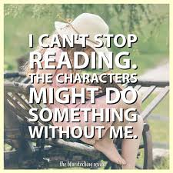
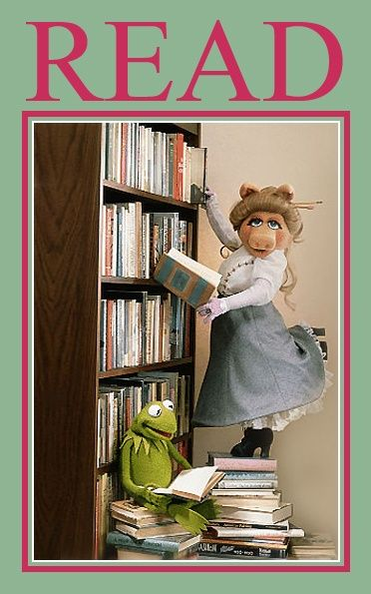
Mrs Boyd, the School Librarian, welcomes all of your own recommendations and book reviews. Let her know what you are reading and if you enjoyed it. If you need help choosing a book, please ask and she will be happy to help.

