Slide 1
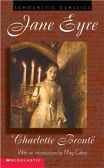
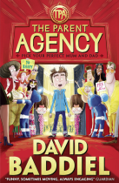
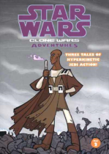
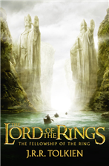
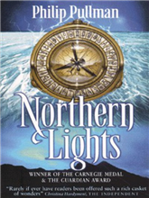
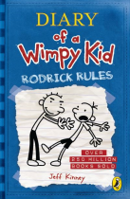
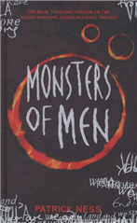
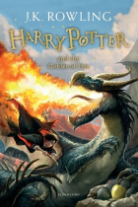
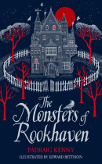
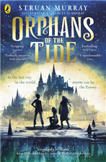
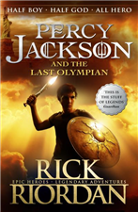
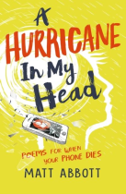
STRANGFORD LIBRARY
TOP
BOOK REVIEWER
COMPETITION

Slide 2
WIN – TOP BOOK REVIEWER AWARD
The school library is stocked with so many amazing books and provides a space where students can browse and borrow books, as well as share recommendations with each other.
We would like to develop the amount of Book Reviews provided by students, as these will help other students choose books to read and encourage hundreds of others to discover new authors, illustrators and series.
Who can Enter?
Open to all Year Groups 8 to 14 – the Library stocks books for all age groups, so call in and take a look.

Slide 3
How to Enter & Win
Visit the School Library and choose which book you’d like to read; borrow it by checking it out with Mrs. Boyd.
Read the Book
Add your review onto ECLIPSE – the School Library App.
If you have read any of your own books, reviews on these can be added too – just search ECLIPSE to make sure the Library stocks the book.
Mrs. Boyd checks and approves all Reviews – these are then made public on the Library App, for other students to read.
The Winner will be chosen based on both the quality of the review(s) and on the number of reviews added.
(How to add a Book Review to Eclipse may be found on the last slide)

Slide 4
What will you win?
ONE WINNER per term – win a £10.00 Amazon Voucher
Entries for Winter Term November- December 2021
Submit reviews by: Monday 13th December 2021
Winner will be announced Wednesday 15th December 2021
Entries for New Year Term January – February 2022
Submit reviews by Friday 4th February 2022
Winner will be announced Wednesday 9th February 2022
Entries for Mid Term 21st February to Easter 2022
Submit reviews by 1st April 2022
Winner will be announced Wednesday 6th April 2022
Entries for Summer Term 26th April 2022 to 30th June 2022
Submit reviews by 17th June 2022
Winner will be announced Wednesday 22nd June 2022
Treat yourself to a new book / art supplies / stationary
Treat yourself to a new book / art supplies / stationary

Slide 5
How to add a Book Review to ECLIPSE
Log onto MySchool
Click on “View All”
Click “Online Learning”
Click “Launch Library App”
When Eclipse opens – type the title of the book or author in the Search area (top right)
If more than one book comes up in the search, click the one you wish to review
When the book information opens Click “Create Review”.
Type in your Review – Save – repeat for another book – or close App.
What is a Book Review?
A Book review is an opinion of a reader about a particular book based on the content, style and storyline.
The main purpose of writing a book review is to draw book lovers’ attention towards the book, captivate the readers and persuade them to read the book. Rather than revealing the whole story.
Find a Book
Read the Book
Consider taking a few notes
Identify the subject
Describe the plot
Form an opinion
Give your enjoyment/recommendation Rating
See Book Review Tips on the next slide.

Slide 6
Book Review Tips
FIRST THOUGHTS – What made you pick this book to read? Was it the cover? Or the title? Or something else? Did a friend recommend it or did you see it somewhere?
AUTHOR & ILLUSTRATOR – Had you heard of the author or illustrator before you choose this book? Have you read any of their other books? Are those books similar to this one?
GENRE – How would you describe the story? Is it an adventure? A mystery? A love story? Are there illustrations or pictures?
CHARACTERS – who are the main characters and how would you describe them? Can you see them clearly in your imagination? Did you identify with any of the characters?
STORY– Think about what happened in the story and can you summarise the action without ruining the story for anyone who hasn’t read it yet?
WHEN – Is the book set in today’s world, or sometime in the future or past? Does that make a difference to the story and your enjoyment of it?
WHERE – Where does the story take place? Is it a familiar place or somewhere really different? If you close your eyes, can you see it in your imagination?
WRITING STYLE – How would you describe the writing style? Simple? Elaborate/ Modern? Old-fashioned? Did you understand all the words? Did you learn any new words?
EMOTIONS – How did this book make you feel? And did it make you feel one emotion or lots of different emotions? How did you feel at the end of the book?
OPINION – Did you like the book and can you tell us why you did or didn’t ? Is it similar to anything else you’ve read? Would you recommend it and if so, to who?

Slide 7
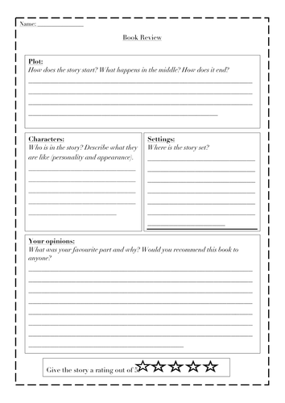
This Template may also help
HAPPY BOOK REVIEWING!

