Slide 1
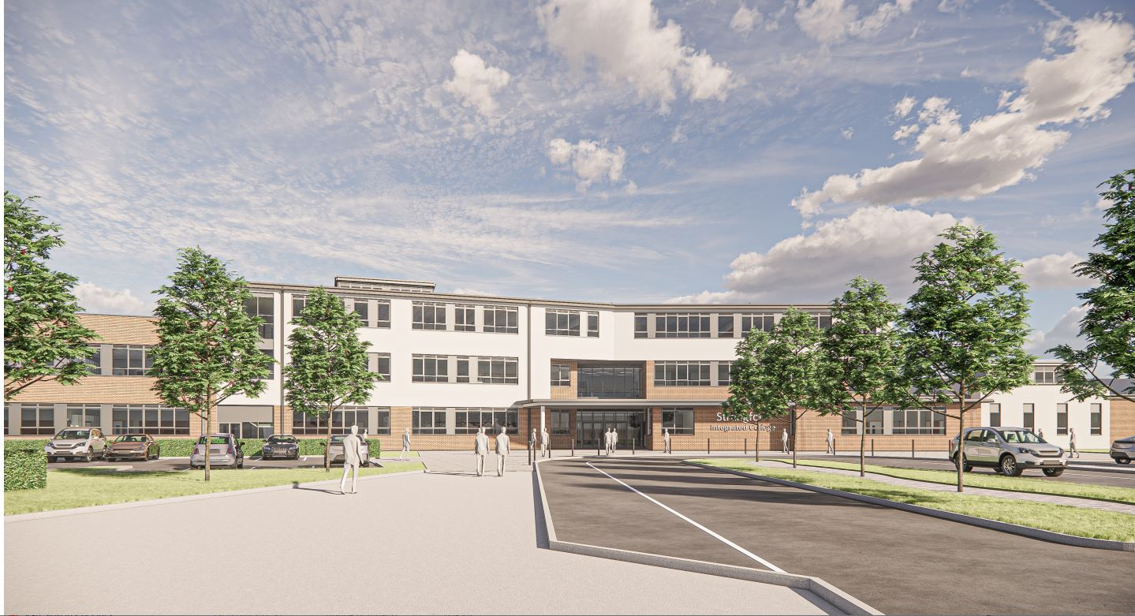
OUR NEW SCHOOL BUILDING!
Work is due to commence w/c 29th April.

Slide 7
When will it be finished?
By September 2025
Science
Technology & Design
Home Economics
Art & Design
Modern Languages
Library
First Aid
College Hall
Sixth Form
Business
Careers
Drama
Music
IT
Pitches

Slide 8
By November 2026
Sports Hall
Mathematics
English
Religious Education
Learning Support
Staff Room
Geography
History

Slide 9
Phase 1/2
Wall/fence along the road at rear from canteen, along rear of science, in around front of SEN/Music, along the rear of M8 &9 and to the rear of Home Economics.
There will be NO access to rear of the College.
M1/2 will move to the playground first.
M3 will move next
Music/ Learning support will demolished .
Additional classrooms will be provided over the summer for Music and Learning Support.
Once the wall is up there will be no work on our side of the site

Slide 10
There will be changes:
Fire assembly point – playground
Physical Education – off site
Music, Learning Support, Business and Geography will all be in a new location over the next few weeks

Slide 11
What can you do to help!
Listen in form class – there will be important announcements about the build
Follow instructions/ rules – they are in place for very good reasons, including your safety!
There will be a new arrangement for going to and from the canteen
There will be a 3m wall, if anything goes over the wall, it will NOT be retrievable
We will keep you updated with video footage
It will be worth it!

